Slide 1
Anti Sleep Glasses For Drivers
Jayanthi Sharma – 22BCE1758
Vibha Rao - 22BCE1957

Slide 2
Table Of Content
Testing Set-Up
Schematic view of the circuit
Block diagram
Code
Outcome
Application
Advantages
Future Scope
Topic
Objective
Concept
Methodology
Components list
Tools Used
Budget
Testing Set-Up

Slide 3
Objective
Sleep is a dynamic process that affects the way our bodies function. Sleepiness results in disrupted brain functioning, such as reduced reaction time or decreased ability for decision-making. When questioned, over 20% of the drivers admit that they have actually fallen asleep at the wheel. Studies over the past 20 years have indicated that sleepiness is a significant factor in road traffic accidents, contributing to 3% to over 30% of such incidents globally.
The primary objective of the this project is to develop a wearable device that can detect signs of drowsiness in the driver and provide timely alerts to prevent accidents caused by falling asleep, particularly while driving or operating machinery. This project aims to enhance safety and reduce the risk of accidents due to drowsiness.

Slide 4
Concept
The primary goal of this project is to detect signs of drowsiness in drivers and provide timely alerts to prevent accidents. We have utilized a microcontroller, open-source Arduino software, and an eye blink sensor to monitor the driver’s alertness. The eye blink sensor measures the frequency and duration of blinks, sending this data to the microcontroller. If the driver's eyelids remain closed for more than 3 seconds, indicating potential sleepiness, a warning signal is immediately triggered. The glasses integrate multiple technologies, including eye-tracking, sensors, and alerts, to effectively detect drowsiness and promptly warn the user, thereby reducing the risk of accidents.

Slide 5
Methodology
1. Breadboard Setup: Assemble the key components—Arduino Uno, eye blink sensor, piezo buzzer, switch, battery and vibrating module on a breadboard.
2. Programming and Testing: Upload a basic sketch to the Arduino Uno that monitors eye blinks and triggers the buzzer if the eye remains closed for more than 3 seconds. Test the system on the breadboard, making any necessary adjustments to ensure accurate detection. Verify that the buzzer and vibrating module function correctly.
3. Soldering and Assembly: Once the system functions correctly on the breadboard, switch to Arduino Nano and solder all connections securely in order to make it compact. After soldering, attach the components to glasses using double-sided tape.
4. Optimization: Streamline the design by arranging the components to ensure comfort and minimize bulk. Optimize the power usage by considering the addition of a rechargeable battery to improve usability and sustainability.

Slide 6
Component list
5V PIEZO buzzer
Wires
9v battery WITH CAP
ARDUINO NANO
Arduino Uno
SPST switch
EYE BLINK SENSOR
FEMALE-FEMALE JUMPER WIRES
VIBRATING MODULE
GLASSES

Slide 7
Tools Used
Soldering IRON
SOLDERING FLUX
DESOLDERING WICK
SOLDERING WIRE

Slide 8
Budget
Arduino Uno original with cable - Rs. 1700
Piezo buzzer – Rs. 40
Jumper wire set – Rs. 136
Eye Blink sensor – Rs. 350
Arduino Nano – Rs. 245
9v battery with cap – Rs. 30
Vibrating Module – Rs. 20
SPST Switch – Rs. 14
Wires – Rs. 120
10. Soldering Iron – Rs. 105
Soldering Flux – Rs. 20
Desoldering Wick – Rs. 20
Soldering Wire – Rs. 20
Total: Rs. 2820

Slide 9
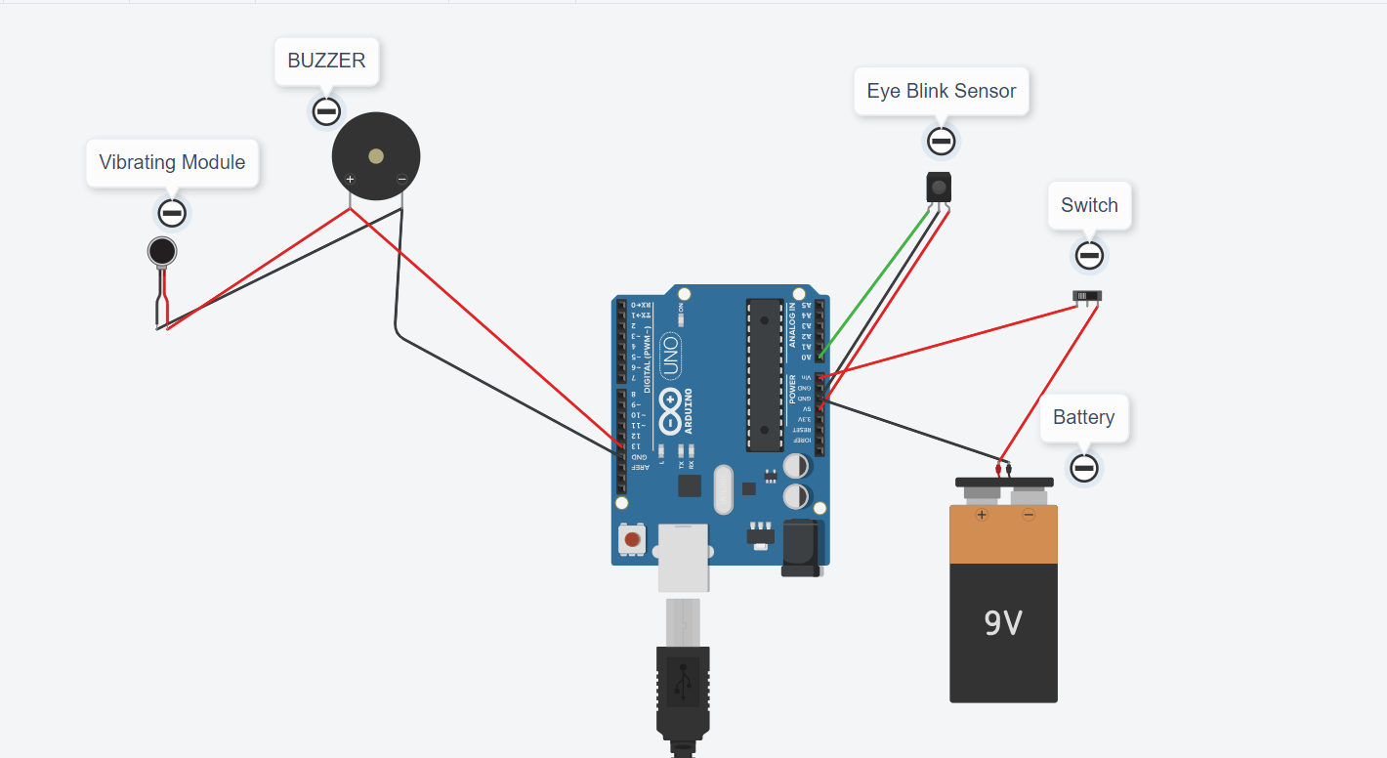
Testing Set-Up

Slide 10
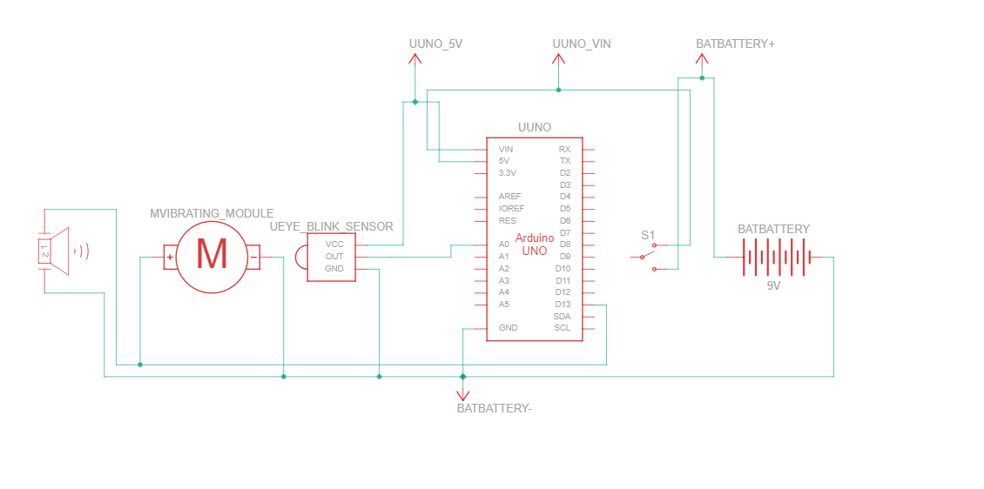
Schematic View

Slide 11
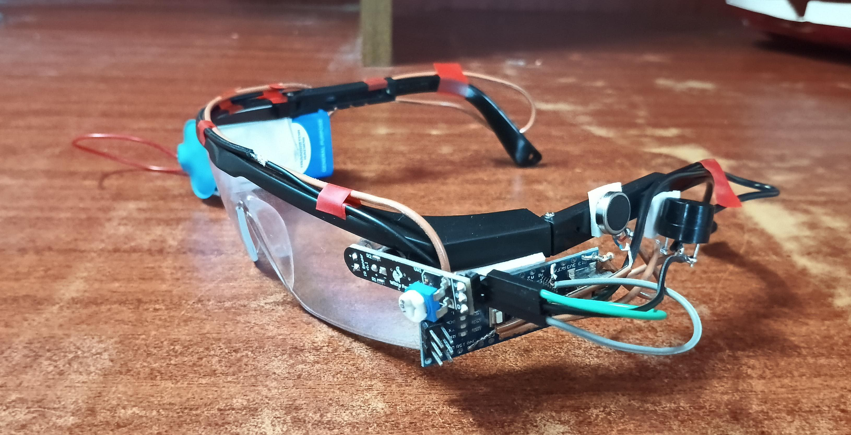
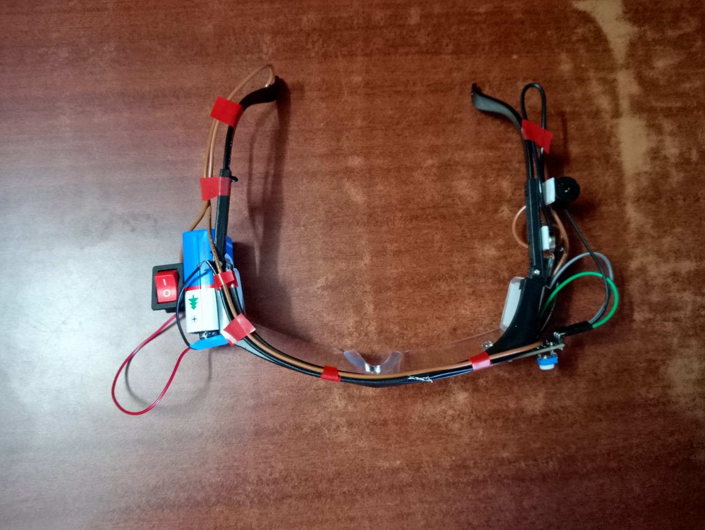
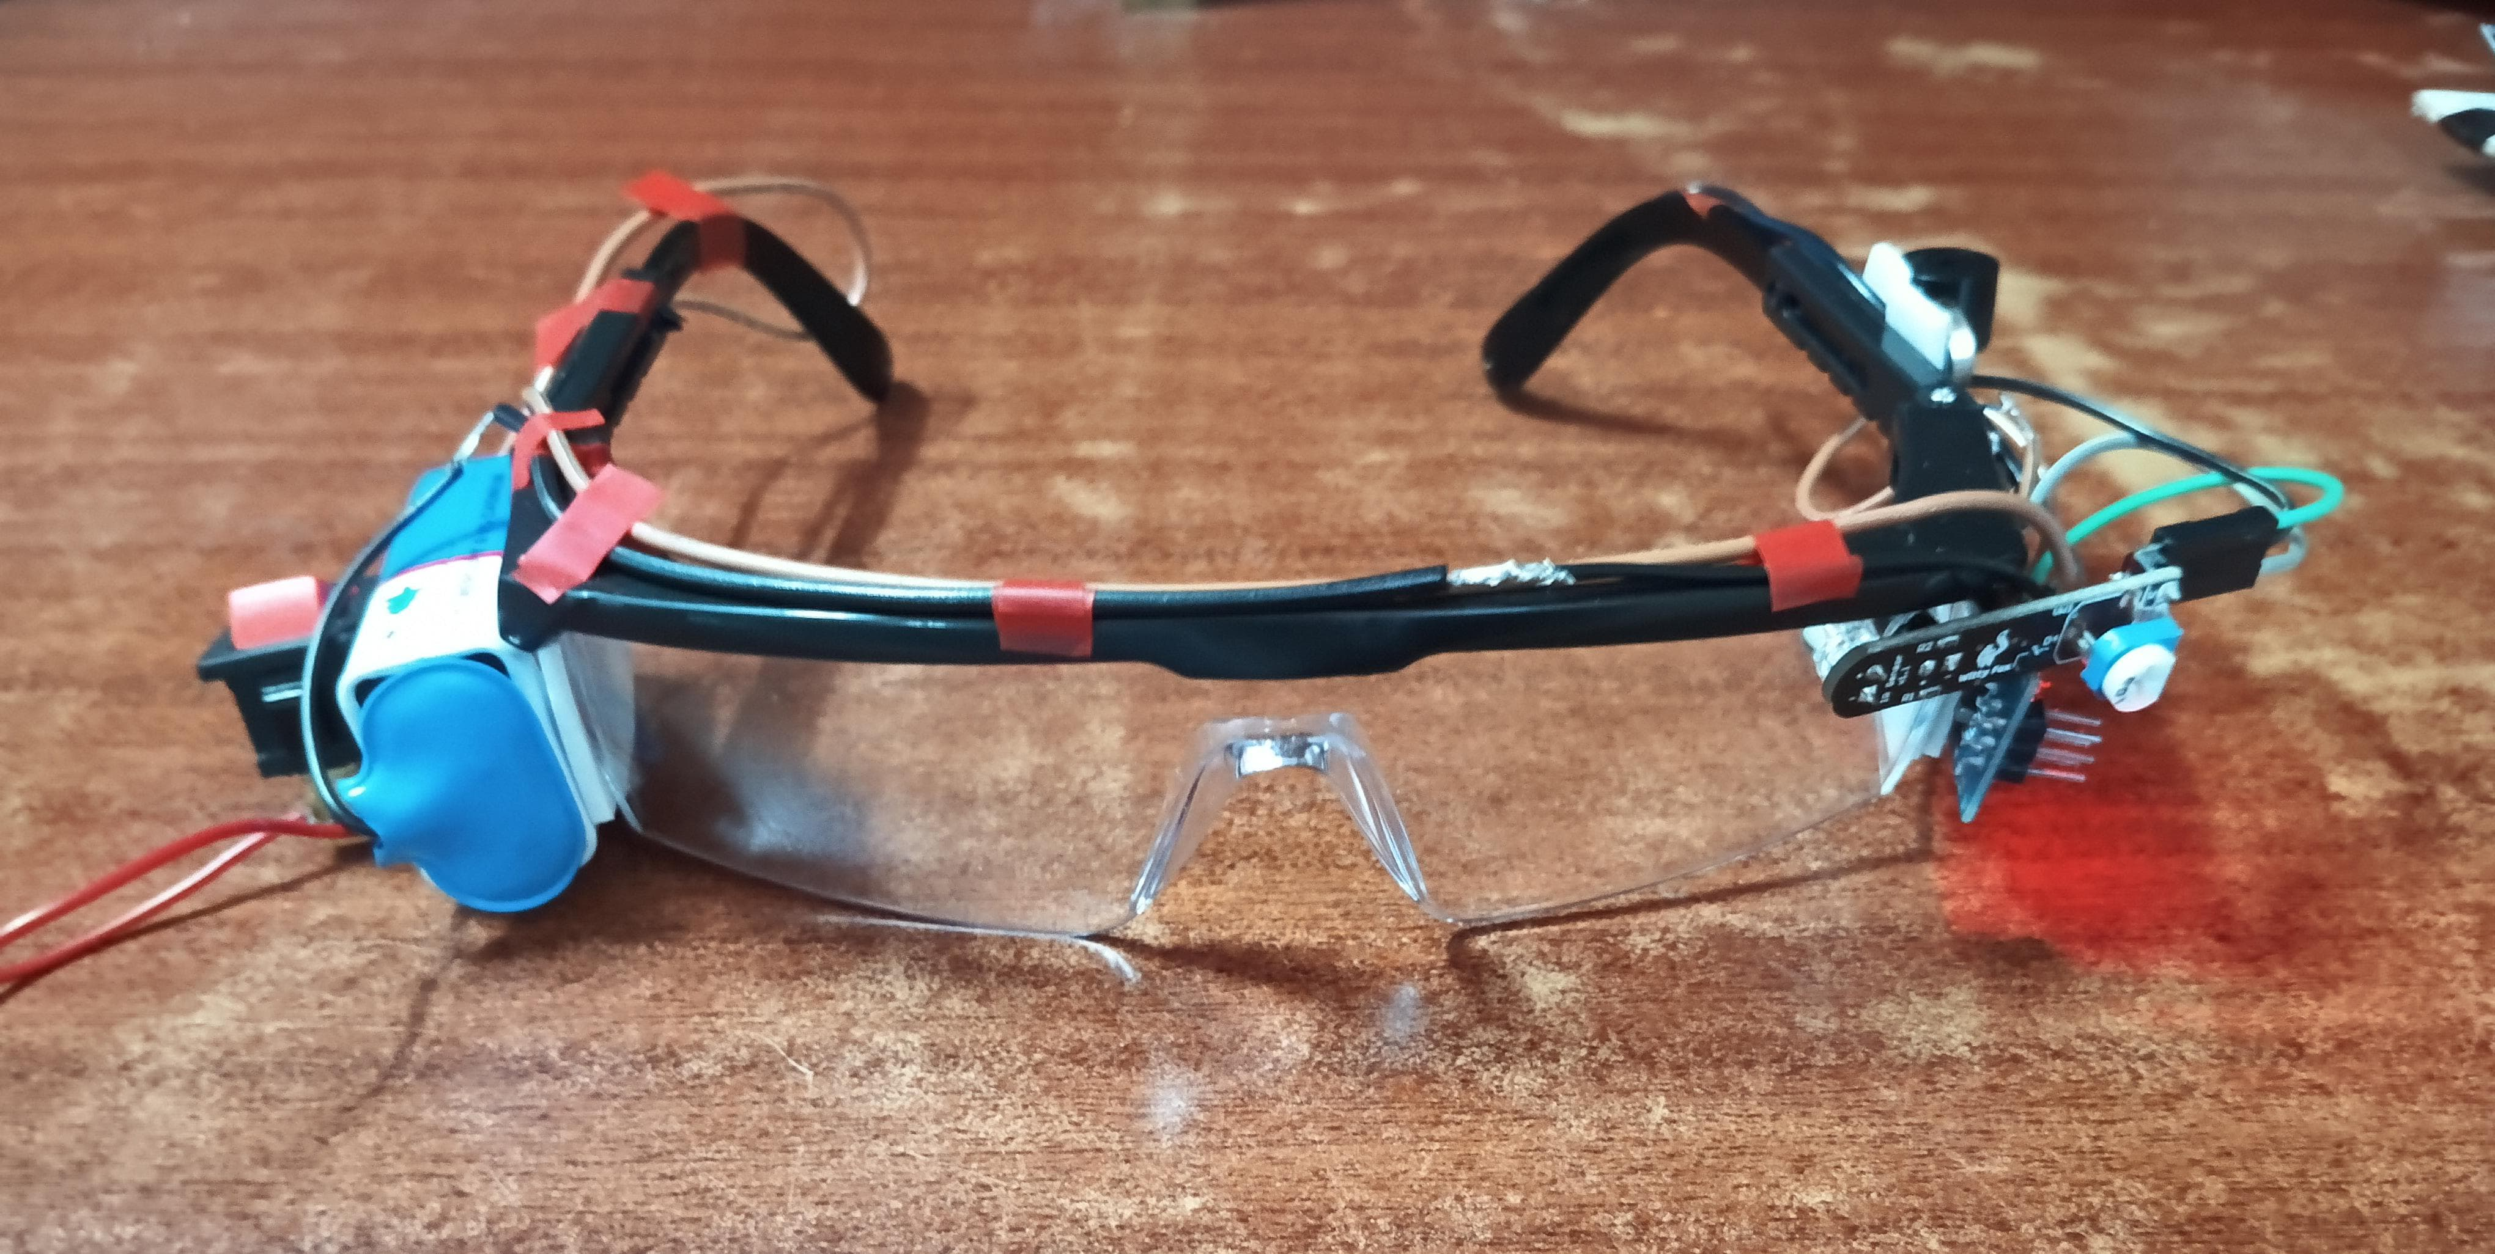
Project Implementation
Side View
Top View
Front View

Slide 12
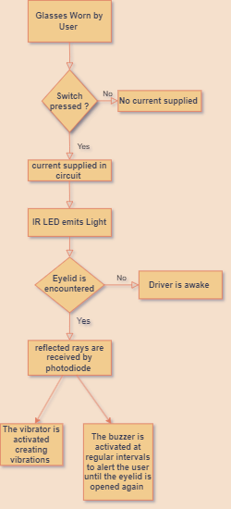
Block Diagram

Slide 13
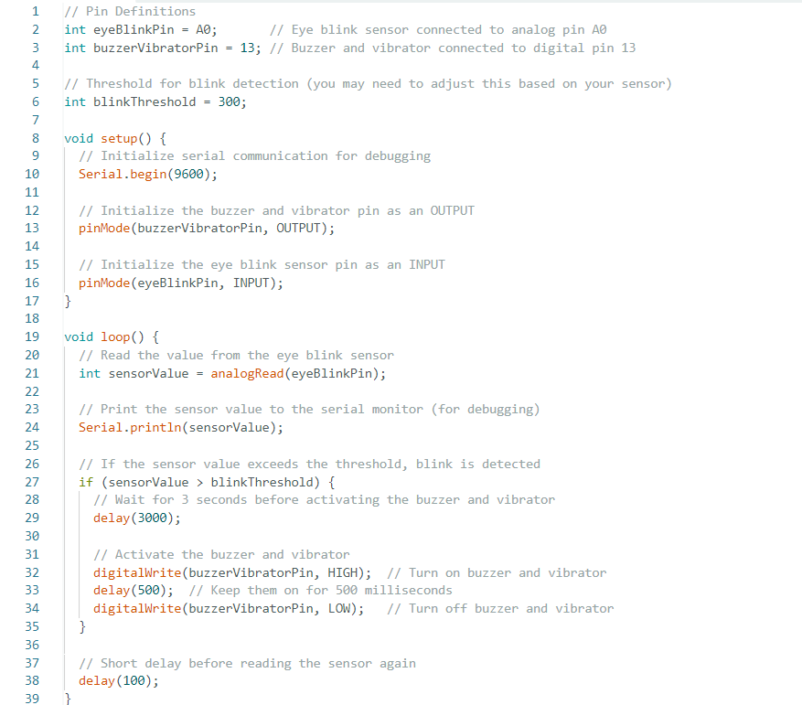
Code

Slide 14
Expected Outcome
Accurate Drowsiness Detection: The device will effectively differentiate between drowsiness and regular blinking, ensuring precise identification of when a driver is truly falling asleep.
Timely Alerts: A warning alarm will activate specifically for drowsiness, alerting the driver without triggering during normal blinking, thus minimizing false positives.

Slide 15
Applications of Anti-Sleep Glasses in Real-Life Scenarios
Long-Distance Driving: Alerts drivers to drowsiness, helping prevent accidents during long or night drives.
Shift Work: Supports workers in maintaining alertness during night shifts, reducing errors and accidents.
Studying or Working Late: Keeps students and professionals focused during late-night study sessions or projects.
Aviation: Assists pilots and air traffic controllers in staying vigilant during long hours of monitoring.
Delivery Drivers: Helps maintain alertness for timely deliveries and reduces road accident risks.
Gaming and E-Sports: Enhances focus and reaction times for gamers during extended sessions.
Research and Development: Ensures scientists remain alert to capture critical observations during long experiments.

Slide 16
Advantages of Our Anti Sleep Glasses
Enhanced Safety: Helps prevent accidents by alerting users to drowsiness, particularly beneficial for drivers and those in safety-sensitive jobs.
Real-Time Monitoring: Continuously tracks blinking patterns to detect signs of fatigue, providing immediate feedback.
Immediate Alerts: Utilizes a buzzer and vibrator to deliver timely notifications, ensuring users stay awake and alert.
Support for Deaf Users: The built-in vibrator provides a tactile alert for users who are deaf or hard of hearing, helping them stay awake without relying on auditory signals.
Customizable Sensitivity: Users can adjust the sensitivity of the eye blink sensor to suit individual needs and environments.
Portability: Designed to be lightweight and easy to wear, making them convenient for daily use.
Cost-Effective Solution: More affordable compared to commercial drowsiness detection systems, making technology accessible to a wider audience.

Slide 17
Future Scope
Automated Vehicle Shutdown: To enhance driver safety, future iterations of the system could incorporate an automated vehicle shutdown mechanism. In cases where the driver fails to respond to the alarm by opening their eyes, the system will initiate a controlled halt of the vehicle, thereby mitigating the risk of accidents.
Reactivation of Vehicle Control: Upon detecting that the driver’s eyes are open again, the system will seamlessly restore vehicle control, ensuring a smooth and safe transition back to normal driving conditions.
Integration of Alcohol Detection: In addition to fatigue monitoring, an alcohol detection system can be integrated. If the system detects alcohol consumption by the driver, it will disable the vehicle's operation, preventing potential accidents and enhancing road safety.
Fatigue Prediction Algorithm: Implement a machine learning algorithm that not only reacts to real-time conditions but also predicts the likelihood of driver fatigue based on prior blink data, time of day, and driving duration. This could warn the driver before critical fatigue sets in.
Temperature and Heart Rate Monitoring: Additional sensors can be incorporated to monitor the driver's body temperature and heart rate, providing additional insights into the driver’s physical state and alertness. This could enable more accurate fatigue detection by combining multiple physiological indicators.

Slide 18
thank you

